Slide 1


Hotel Aggregator Analysis by with Microsoft Power BI Moses O. Kokumo

Slide 2
Contents
Introduction
Descriptive of Data Set
Project Objectives
Data Visualization
Findings
Recommendations
Conclusion

Slide 3

Introduction
This project aims to analyze a dataset of hotel aggregators listing using Microsoft power BI.
The dataset comprises of various attributes related to listing , host reviews and availability.
The objective is to create comprehensive visualizations and insights that shed light on trends, patterns, and factors influencing the performance of listings.
Using power BI, key metrics such as pricing, availability, host characteristics and review scores have been used to derive actionable insights for improving overall quality and competitiveness of listings.

Slide 4
Description of Data Set
The data set consists of the rows below:
1. id: Unique identifier for each listing.
2. listing_url: URL of the listing on the hotel aggregator platform.
3. scrape_id: Identifier for the data scraping event.
4. last_scraped: Date of the last data scrape.
5. source: Source of the listing information.
6. name: Name of the listing.
7. description: Description of the listing.
8. neighborhood_overview: Overview of the neighborhood where the listing is located.
9. picture_url: URL of the listing's picture.
10. host_id: Unique identifier for the host.
11. ... (and many more columns capturing details about hosts, location, property type, room details, amenities, pricing, availability, reviews, and other relevant information)

Slide 5

Project Objectives
1. Geographical Insights:
- Visualize the distribution of listings on a map to identify popular neighborhoods.
- Explore the geographical concentration of listings and host locations.
2. Pricing and Availability Analysis:
- Analyze pricing trends based on property types, room types, and accommodation capacity.
- Investigate the availability of listings over time and identify peak periods.
3. Host Performance:
- Evaluate host characteristics, including super host status, response times, and verification methods.
- Explore correlations between host attributes and listing performance.
4. Review Scores and Guest Satisfaction:
- Examine review scores and their impact on overall listing performance.
Identify areas for improvement based on specific review categories.
5. Property Type and Room Analysis:
- Analyze the distribution of property types and room types.
- Explore trends in the popularity of specific accommodation setups.

Slide 6
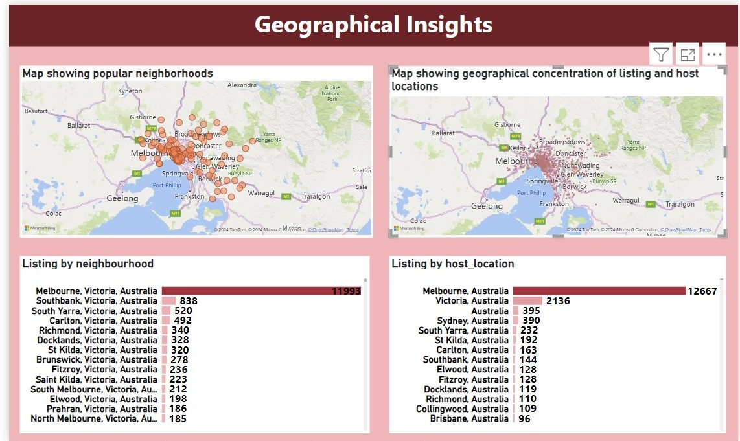
Geographical Insights.

Slide 7
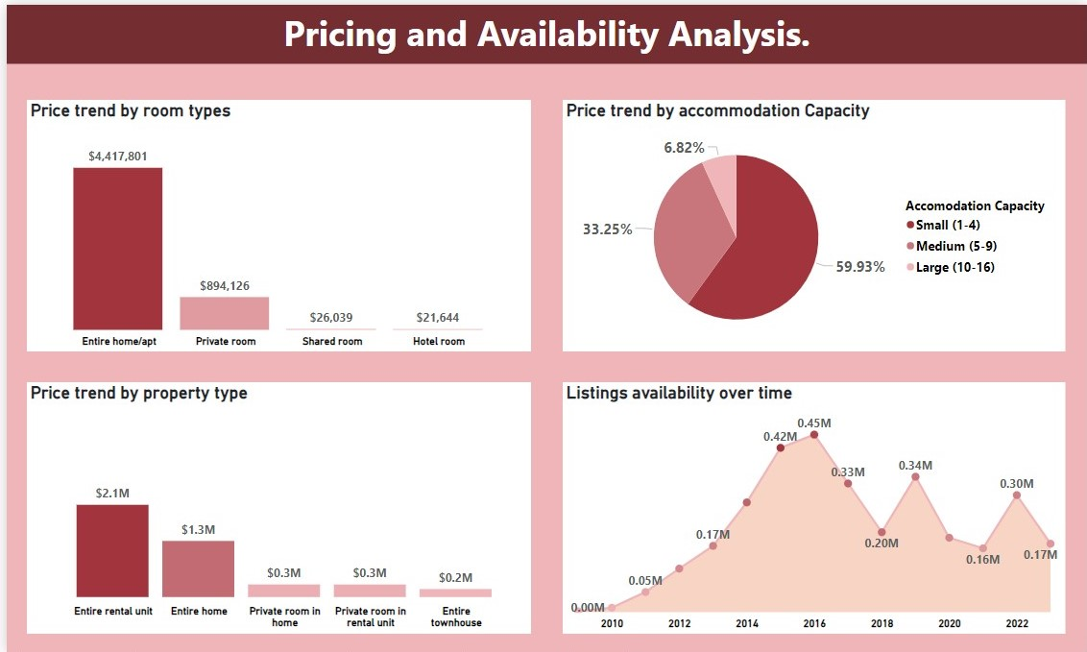
Pricing & Availability Analysis

Slide 8
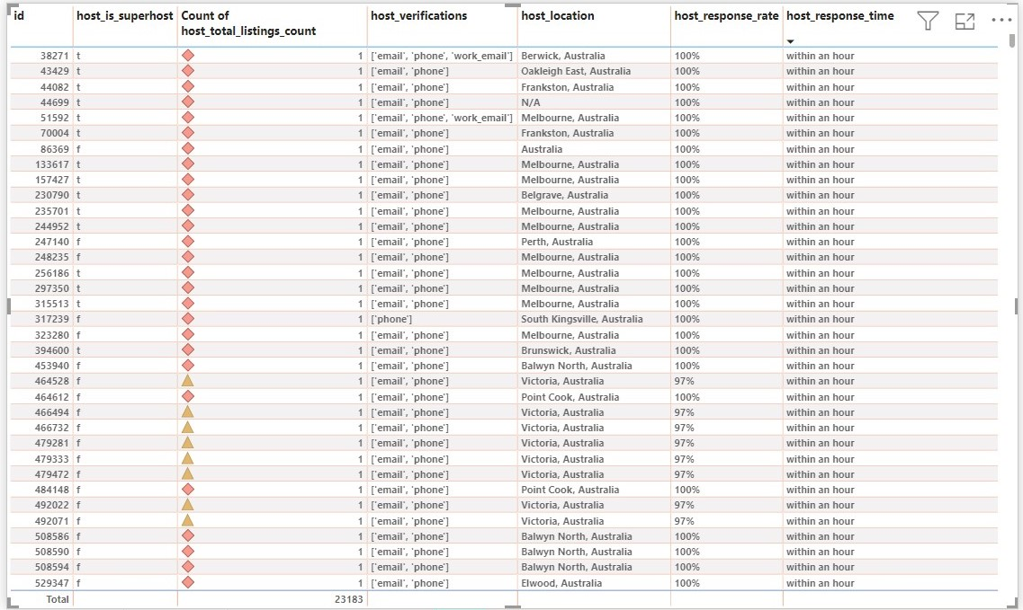
Host Performance

Slide 9
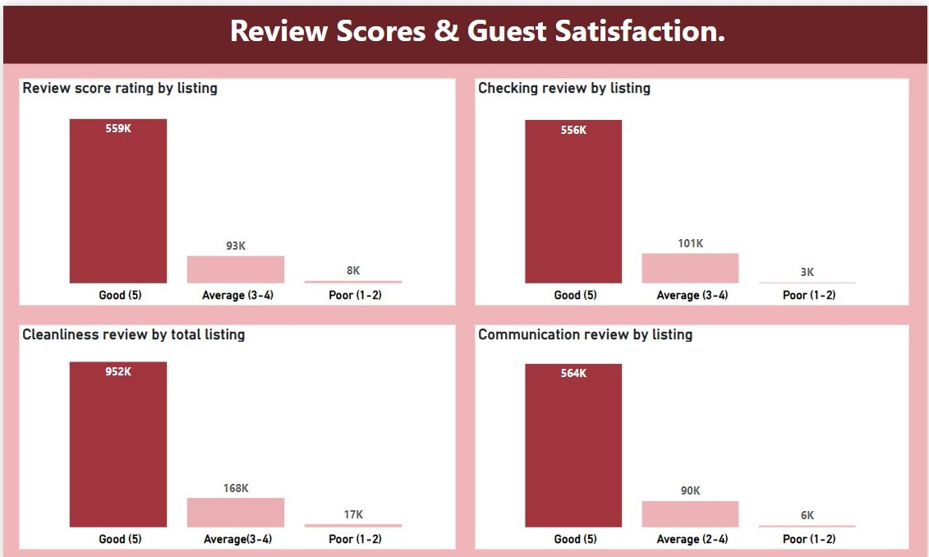
Review Scores & Guest Satisfaction.

Slide 10
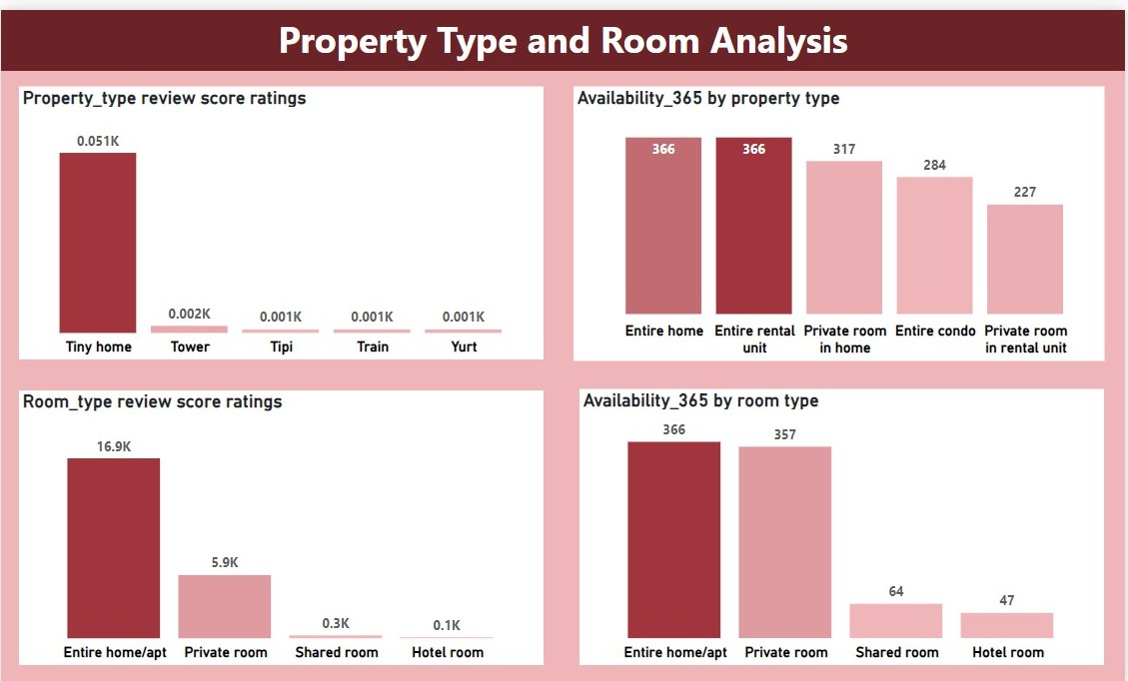
Property Type and Room Analysis

Slide 11
Findings
Geographical insights.
Popular neighborhood: Melbourne, Victoria, Australia top the listings.
Host concentration: The neighborhood of Melbourne, Australia show high concentration of host.
Pricing and Availability Analysis.
Pricing Trend: Entire home/apartment have the highest price per room type while Entire rental unit have the highest price per property type.
Availability patterns: The highest availability was observed in 2016.
Host Performance.
Super Host impact: Listing do not attribute a significant influence to being a super host on listing performance.
Response time and verification: Positive correlation were found between prompt response time, verification methods and good performance ratings.
Review and Guest Satisfaction.
Review score impact: there is good rating on cleanliness, checking's, communication and the overall rating is okay. However, improvement is required on cleanliness.
Property type & Room analysis.
Property and room type analysis: Tiny home has the highest rating in property while Entire home/apt top the rating in the room type.
Popularity trend: Entire home has the highest availability_365 in the property type while Entire home /apt top the availability_365 in the room type.

Slide 12
Recommendations
Geographical Insights:
Explore opportunity to enhance listing in popular neighborhood like Melbourne and Southbank
Consider marketing initiatives life offers and promotions to further engage host in high concentration areas.
Pricing and Availability Analysis:
Optimize pricing strategies, especially for Entire and private properties to maximize revenue potentials.
Monitor availability trend closely particularly peak periods like the observed high availability in 2016, to ensure optimal listing performance.
Host performance:
Provides support and resources for host to improve response times and verification methods, as they positively impact performance ratings.
Review Scores and Guest Performance:
Offer training or guidance to host on maintaining high response and acceptance rate to boost review scores.
Implement initiatives to improve overall guest satisfactions.
Property Types and Room Analysis:
Consider promoting entire Rental units and Entire homes as they dominate the market, while also highlight the popularity of private rooms.

Slide 13
Conclusion.
In conclusion, the analysis of the hotel aggregators dataset has provided valuable insights into various aspects of listings, host performance, and guest performance. Key findings highlight opportunities for optimizing pricing strategies, enhancing host performance and addressing guest preferences. By leveraging this insights and implementing targeted recommendations, we can strive to improve the overall quality and competitiveness of listing on the platform. Moving forward, continued monitoring and adaptation will be essential to staying responsive to market dynamics and maintaining high level of service excellence.

Slide 14

Thank You

